Slide 2
DHHS Salary Cap:
A Quick Primer
From Proposal to Effort Certification
Bridgett Molinar, Research Administrator, SMPH
Jennie Bell, Campus Effort Compliance Manager

Slide 3

Payroll
Salary Cap
Salary cap is a legislatively-mandated provision limiting the direct salary for individuals working on DHHS awards
It is an effective salary limitation of the award.
Salary cap rates are available at: https://grants.nih.gov/grants/policy/salcap_summary.htm
RSP Salary Cap page: https://rsp.wisc.edu/awardmgt/DHHSSalCap.cfm
Notes:
Bridgett BMM- Every dollar of effort is comprised of an allowable salary payment directly charged to the award and a required salary “cap gap”

Slide 4
Payroll
Salary Cap
DHHS usually updates salary cap levels sometimes around Jan-Mar, so it’s a good idea to check before proposal submission. Once released by HHS, Notice is sent to the College/School group.
---
Note that the salary lookup tool for C-basis employees provides their 9-month salary rates, so they might still be over the cap:
$221,900/ 12 = $18,491 per month * 9 months = $166,425 salary cap for C-basis
---
When the updated salary cap level is announced, awards should be updated with the new effective date / rate
UW Madison uses the new rate effective date in the Notice, good to annually check and update
Notes:
Bridgett

Slide 5
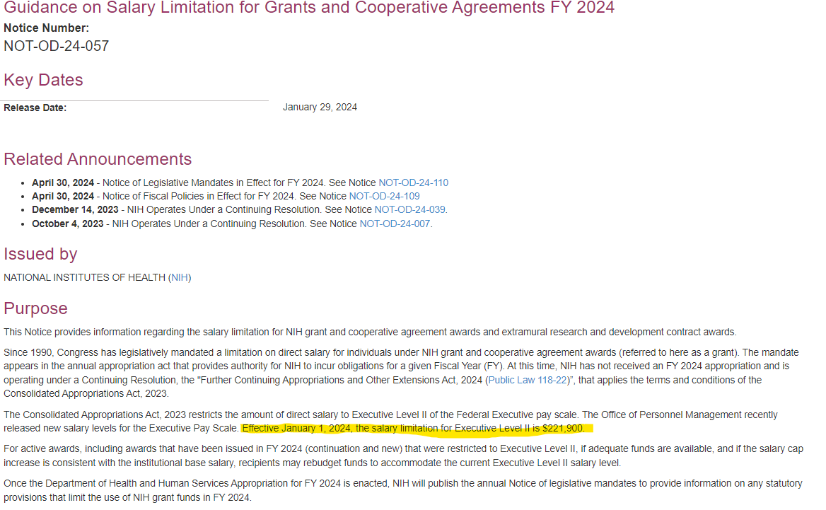

NIH Notice on Salary Cap Update
Notes:
Bridgett Highlight effective rate & date

Slide 6
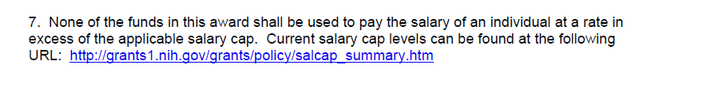
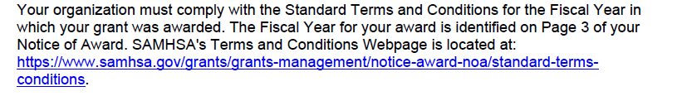
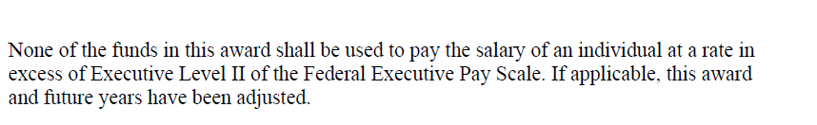
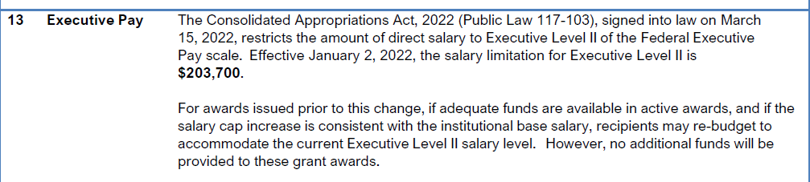
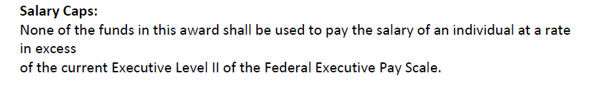

Notice of Award Language
National Institutes of Health (NIH)
Substance Abuse and Mental Health
Services Administration (SAMHSA)
Agency for Healthcare Research and Quality
(AHRQ)
Food and Drug Administration
(FDA)
Centers for Disease Control and Prevention (CDC)
Notes:
Bridgett

Slide 7






Who is Affected?
Anyone over $221,900 annualized salary/FTE rate in a pay period
Folks paid on HHS Direct/Flow Through awards
https://www.hhs.gov/about/agencies/hhs-agencies-and-offices/index.html
Notes:
Jennie

Slide 8
DHHS Salary Cap
How much can I include in my budget?
PI Salary: $250,000 – 30% effort, Academic Appt
Cap: $221,900
Request: $66,570 salary/year ($221,900 x 0.3)
Notes:
Bridgett

Slide 9


DHHS Salary Cap
How much can I include in my budget?
RAMP Budget View
Notes:
Bridgett

Slide 10
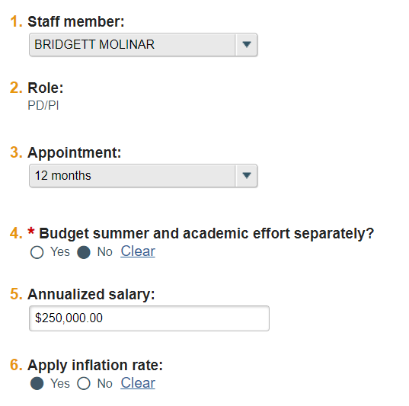
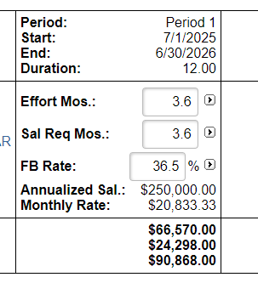
DHHS Salary Cap
Quick note: If you have 9-month appointees, update the 'Annualized Salary' to $ / 9 x 12
Notes:
Bridgett

Slide 11
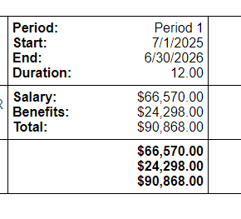
DHHS Salary Cap
RAMP *does* do the math for folk over the salary cap. However, before moving to the SF424- update the annualized salary to the DHHS salary cap.
Notes:
Bridgett

Slide 12
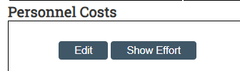
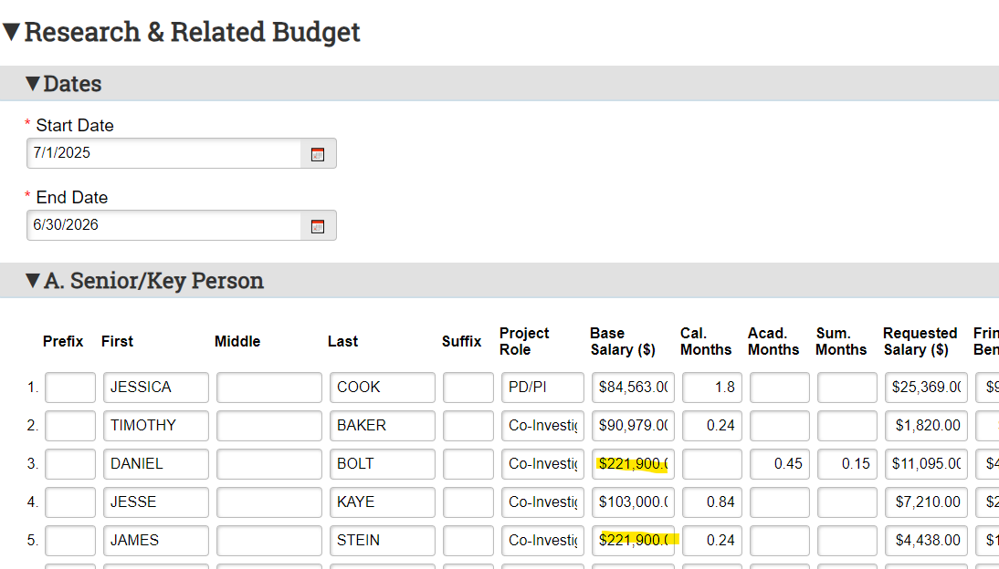
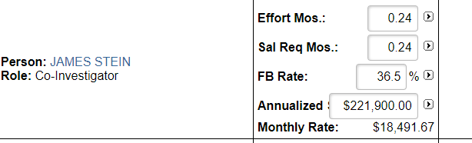
DHHS Salary Cap
How much can I include in my budget?
Notes:
Bridgett

Slide 13
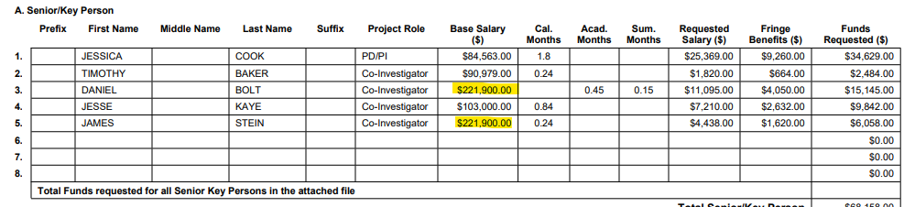
DHHS Salary Cap
How much can I include in my budget?
SF424 View
Notes:
Bridgett

Slide 14
DHHS Salary Cap
How much can I charge?
Cap amount / # of biweekly payroll (year) = max 100% salary on all DHHS funding
$221,900 / 26 = $8,534.62
Allowable % on DHHS differs for everyone:
Cap amount / annualized payroll = max % of salary on DHHS funding
$221,900 / $250,000 = 88.76%
Notes:
Jennie

Slide 15
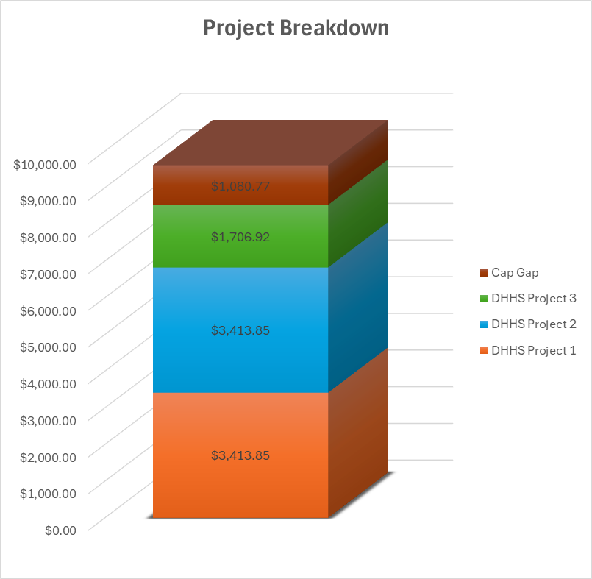
DHHS Salary Cap
Max DHHS funding is split across all eligible DHHS awards
$8,534.62 Max
DHHS Funding
Notes:
UPDATE

Slide 16
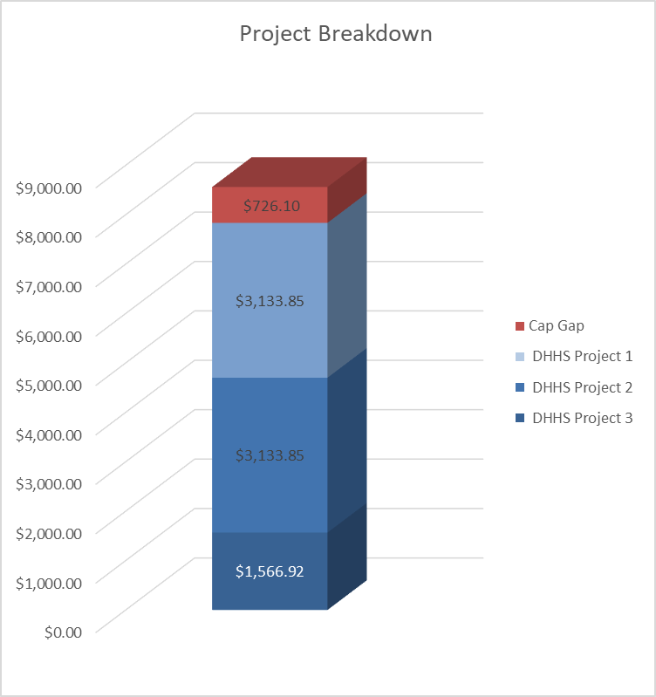
DHHS Salary Cap
“Cap Gap” is the amount of biweekly salary over the max DHHS funding limit
$1,080.77 “Cap Gap”
Notes:
UPDATE

Slide 17


DHHS Salary Cap
Cap Gap MUST consist of non-sponsored funding
Other sponsored funds (NSF, industry, etc.) cannot count toward Cap Gap requirement
$1,080.77 “Cap Gap”
Notes:
UPDATE

Slide 18
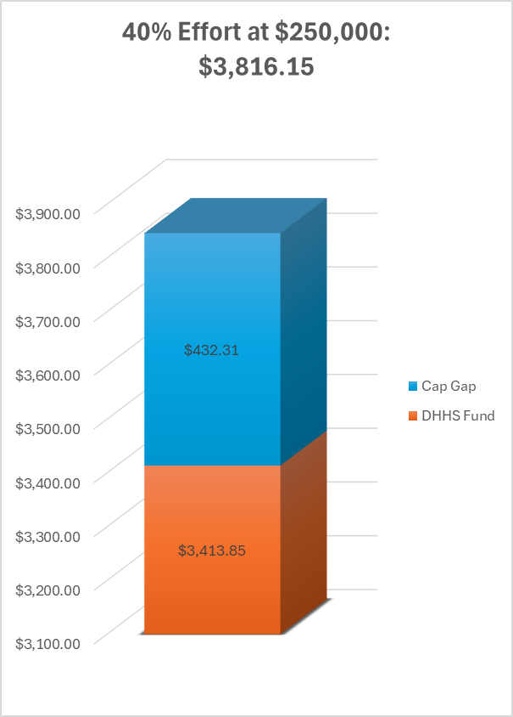
DHHS Salary Cap
Funding must be pro-rated based on the % of effort and/or FTE
Use the max allowable %, based on annual salary
Example:
$250,000/ $221,900 = 88.76% max allowable
Project at 40%:
40% * 88.76% =
35.50% allowable on DHHS ($3,413.85)
Notes:
UPDATE

Slide 19
DHHS Salary Cap
What about certifying effort?
Certification will include the amount paid from the DHHS project + the cap gap amount.
The PI should certify a total of $3,816.15 on this project.
Notes:
UPDATE—Include Info on what ECC looks like??

Slide 20
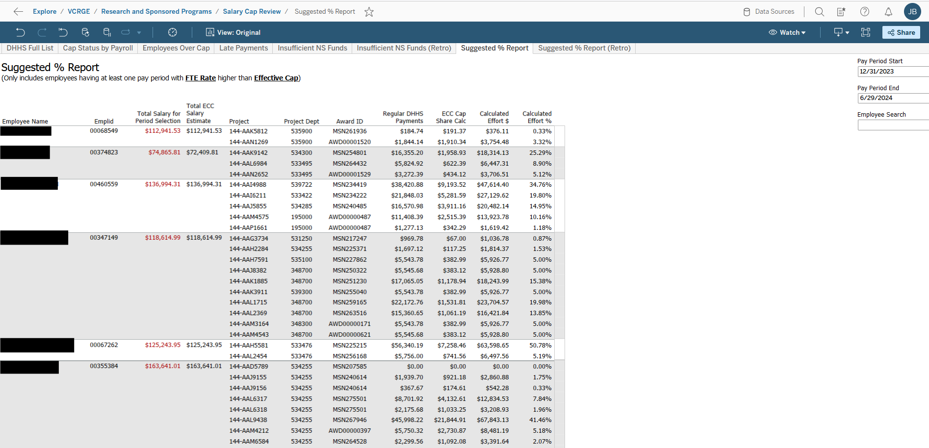

Slide 21
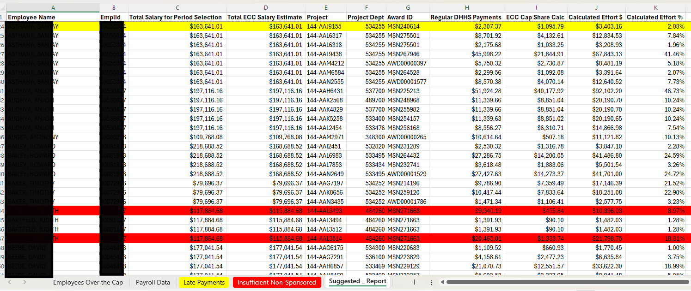
Salary Cap Report – Suggested tab

Slide 22
Salary Cap Report – Suggested tab

Slide 23
Salary Cap Report – Suggested tab

Slide 24
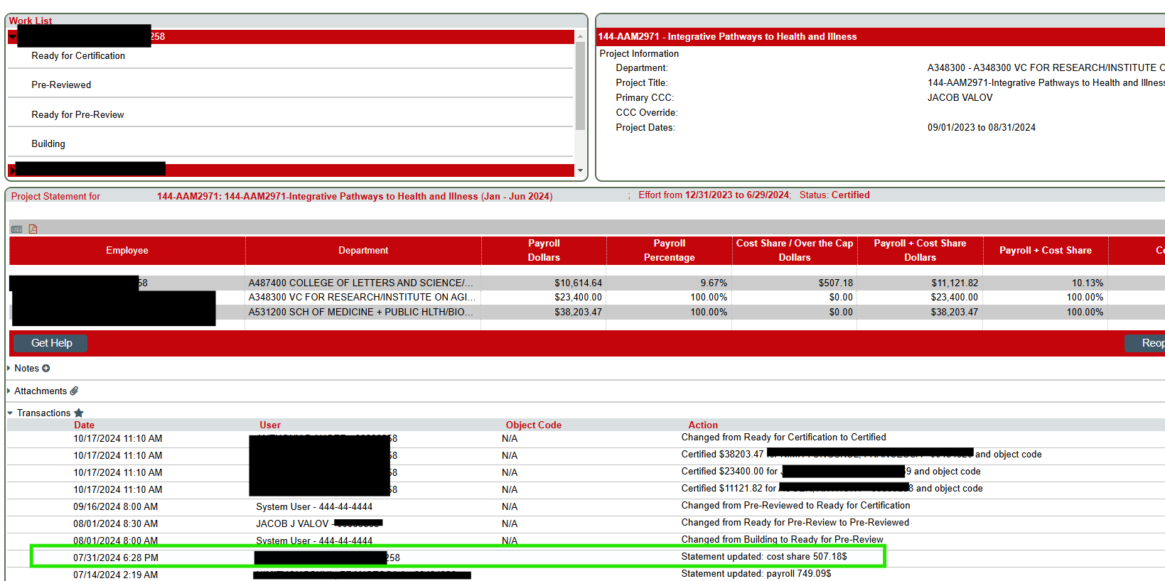

Slide 25
Salary Cap Report – reds and yellows

Slide 26
Salary Cap Report – reds and yellows
The third tab shows projects with pay on it after the end date.
The fourth tab shows individuals who do not have sufficient non-sponsored funding for their existing pay on DHHS grants.

Slide 27
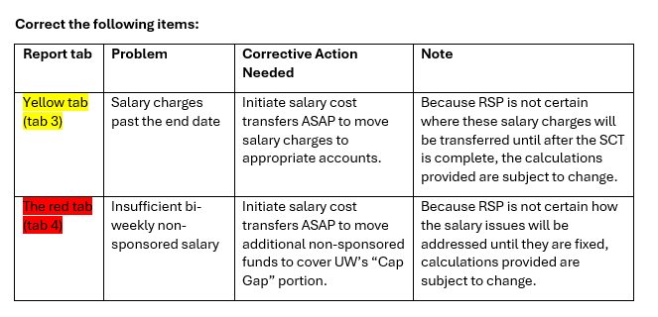
Salary Cap Report – reds and yellows

Slide 28
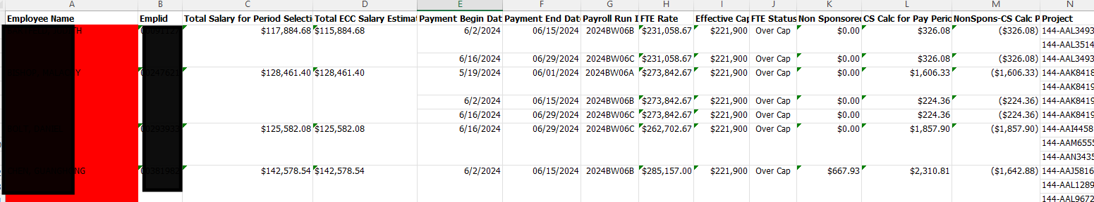
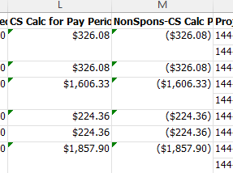
Salary Cap Report – reds

Slide 29
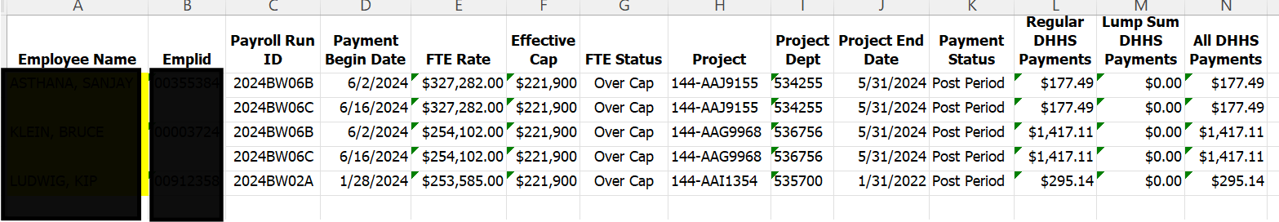
Salary Cap Report – yellows

Slide 30
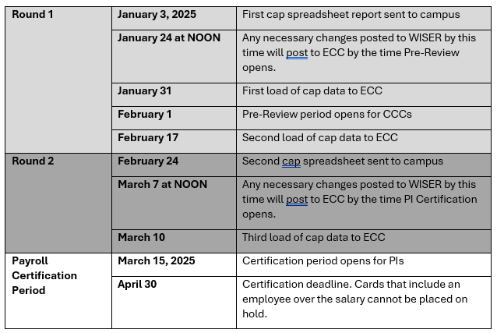
Next Salary Cap Review Schedule

Slide 31
Salary Over the Cap – Current vs. Future State
Current State
Manual calculations required to appropriately allocate funding in HRS between allowable award payment and salary cap
Future State
Payroll Costing Allocations will reflect 100% effort on the grant worktag
Workday will prorate the salary charges automatically as payroll runs

Slide 32
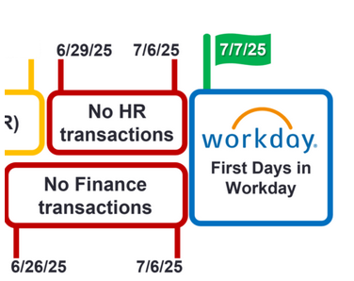
Workday Transition and ECC
Period of performance | Pre-Review and Cert Period Schedule | ERP System for Viewing Finances | ERP System for Transfers | Version of ECC
July-Dec 2024 | Feb 1 - April 30, 2025 | SFS | SFS | Old - SFS data source
Jan-June 2025 | Aug 1 - Oct 31, 2025 | SFS | Workday | Old - SFS data source
July-Dec 2025 | Feb 1 - April 30, 2026 | Workday | Workday | New - WD data source

Slide 33
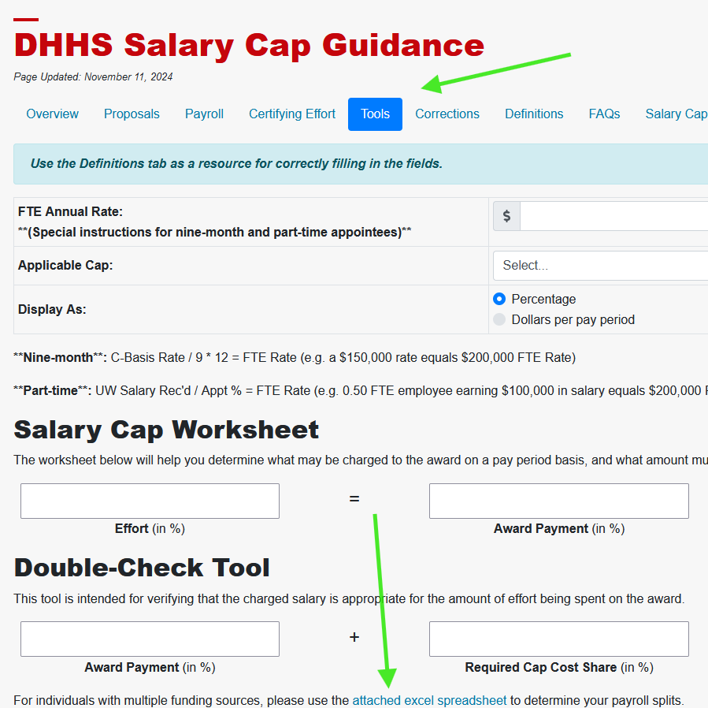
Resources
DHHS Salary Cap Guidance
https://rsp.wisc.edu/awardmgt/DHHSSalCap.cfm

Slide 34
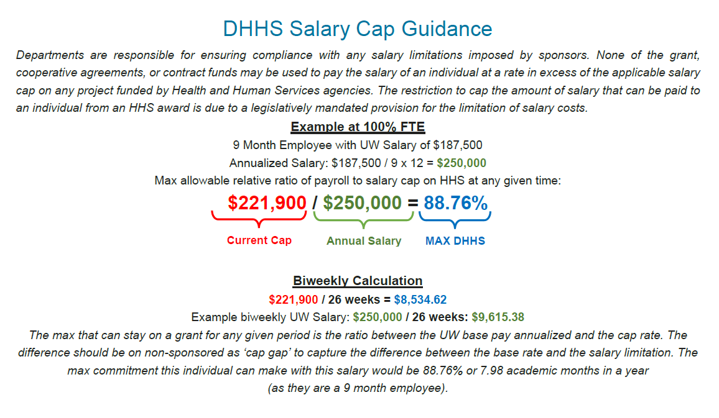
Notes:
Further guidance can be found at https://rsp.wisc.edu/awardmgt/DHHSSalCap.cfm
Tools are on this page to assist with calculating the applicable payroll split for eligible staff, and include a downloadable spreadsheet to determine splits with multiple funding sources.

Slide 35
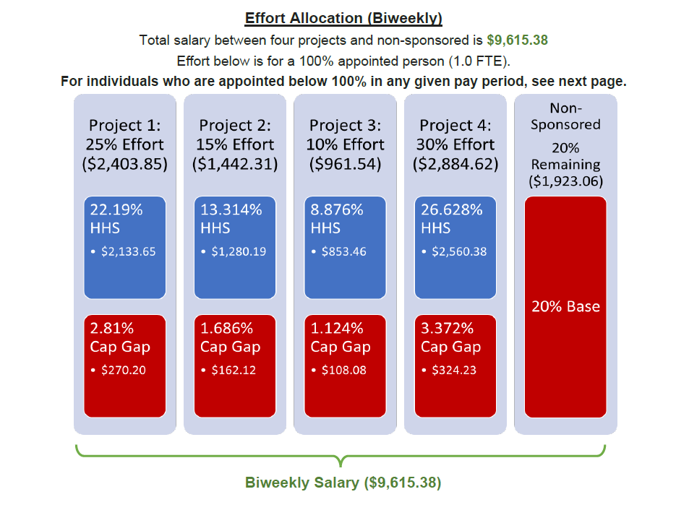

Slide 36
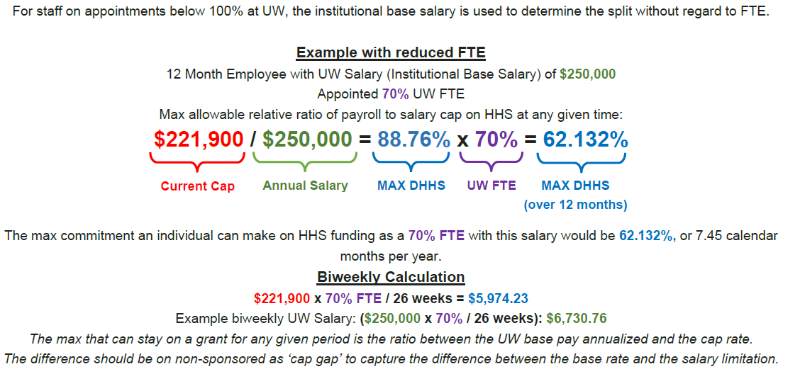

Slide 37
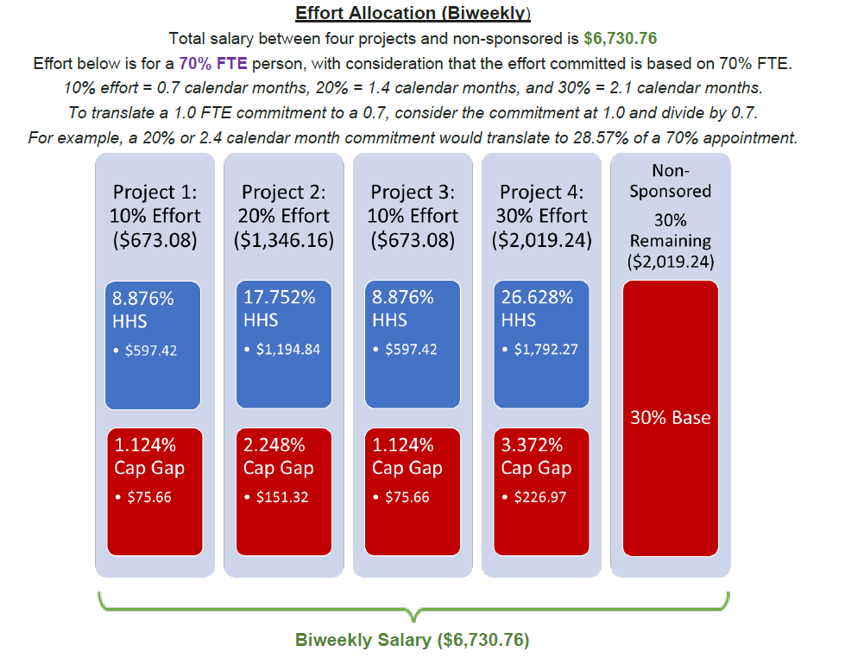
Notes:
Further guidance can be found at https://rsp.wisc.edu/awardmgt/DHHSSalCap.cfm
Tools are on this page to assist with calculating the applicable payroll split for eligible staff, and include a downloadable spreadsheet to determine splits with multiple funding sources.

